Slide 1

Gary Fox
Database Administrator – Team Lead
Xerox, Wilsonville

Slide 2

  Overview
  Various Options
  Requirements
  Management and Maintenance
  Initial Setup
  Views

Slide 3

Worked with Oracle databases since version 6
Database Administrator since version 7
DBA Team Lead at Xerox in Wilsonville the past five years
Designed and taught various classes for companies, colleges and communities
    Oracle
    Unix
    Math
    Folk dancing

Slide 4

Currently on a project to change our Disaster Recovery from a 3rd party site to internal ones
Data Guard is the method we are using for Oracle databases
Changed first one 2 years ago with production database in Oregon and standby in New York
There are many other parts to the picture
    Windows application servers or VMs
    Unix zones
    SAN block replication
    NAS file replication
    Network

Slide 5

Oracle Data Guard provides the ability to create and maintain Standby databases at one or more sites
These protect Oracle databases from database and server failures as well as site disasters
Failover to one of the alternate sites can be set to happen automatically (fast-start failover) or manually if the primary database is not usable
Updates to Primary are reapplied in Standby as they occur

Slide 6
Advantages
Recovery Point Objective (RPO) is very small or zero
Recovery Time Objective (RTO) is measured in minutes
Updates are done in Standby, so any potential physical corruption is not carried over
If it gets behind, FAL client on Standby requests FAL server on Primary to send archive logs
FAL – Fetch Archive Log
Disadvantages
Requires duplicate server, database, storage to be constantly in use
  May be on the same server as the Primary
Licenses for duplicates are needed
People can’t decide if data guard is one word or two

Slide 7

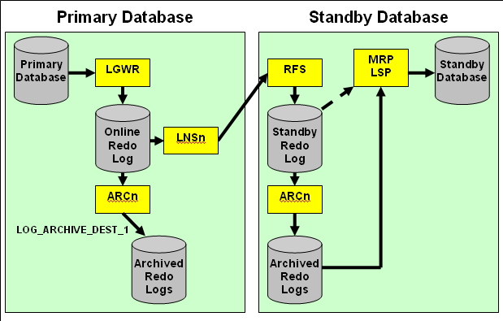
Background
Processes
LGWR Log Writer
ARCn Archiver
LNSn Log Network Server (Data Guard specific)
RFS Remote File Server (Data Guard specific)
MRP Managed Recovery Process (Data Guard specific for Redo Apply)
LSR Logical Standby Process (Data Guard specific for SQL Apply)

Slide 8

Physical Standby – Redo Apply
  An exact replica of Primary
    Recovery applies changes block-for-block using the physical rowid
  Is always running in recovery mode
  Can be opened read-only by temporarily stopping Redo Apply
  Redo Apply can be active while opened read-only with Oracle Active Data Guard 11g
    Can be used for offloading read-only work from the primary database.
    Requires extra license
  Most examples in this presentation are from a physical standby

Slide 9
Logical Standby – SQL Apply
  Executes SQL statements to apply redo log data
  Structure, indexes may be different
  Is open read-only
  Can be used for reports, backups, as well as disaster recovery
  The following are not supported
      BFILE
      Collections (including VARRAYS and nested tables)
      Multimedia data types (including Spatial, Image, and Oracle Text)
      ROWID, UROWID
      User-defined types
      eBusiness Suite
      etc

Slide 10
Snapshot Standby
  Updateable
  Not in recovery mode
  Redo from Primary is not applied until Snapshot is converted to Physical Standby
  Any updates made in Snapshot are discarded
  Enough space is needed for all unapplied logs

Slide 11

Sends transactions to one or more Standby databases
  Can send transactions from redo logs as they are written (real-time apply)
  Immediately applied on Standby
If transactions fall behind, will automatically revert to log shipping replication
  Massive updates on Primary database
  OS patching of Standby server
  Network problems
Enterprise Manager can send alerts if gets more than a specified time behind

Slide 12
Can be set to wait a specific time to protect against errors
log_archive_dest_2 = "SERVICE=mkslsb DELAY=60 "
Can be set without real-time apply
ALTER DATABASE RECOVER MANAGED STANDBY DATABASE
DISCONNECT FROM SESSION;
Can be set to use real-time apply
ALTER DATABASE RECOVER MANAGED STANDBY DATABASE
USING CURRENT LOGFILE DISCONNECT FROM SESSION;
ALTER DATABASE START LOGICAL STANDBY APPLY IMMEDIATE
DISCONNECT FROM SESSION;
Notes:
DELAY is set in Primary

Slide 13

  Maximum Performance
  Primary does not wait for an acknowledgement from Standby
  Maximum Protection
  Does not commit until redo written to at least one Standby
  Creates guaranteed RPO of 0 seconds – no data loss
  Causes potential slowness on Primary database as it has to wait for an acknowledgement from Standby
  Should have at least 2 Standbys
Maximum Availability
  Is Maximum Protection unless a Standby fails
  Then becomes Maximum Performance
Set in LOG_ARCHIVE_DEST_n
ALTER DATABASE SET STANDBY DATABASE TO MAXIMIZE {AVAILABILITY | PERFORMANCE | PROTECTION};

Slide 14

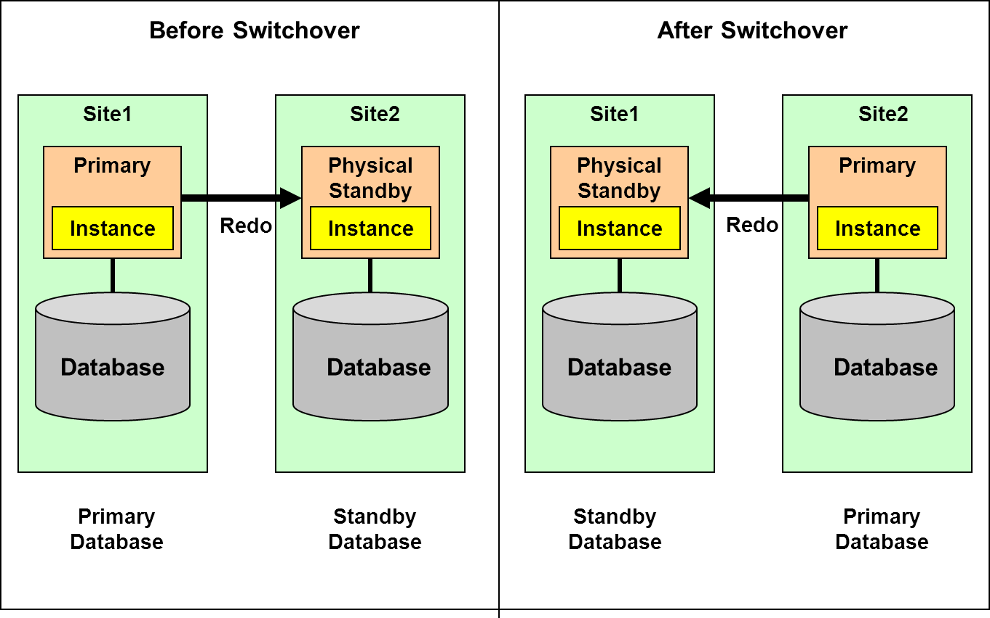
This would be used for any testing, and for any disaster where a few minutes exist before shutdown
No data loss
Primary and Standby switch roles
  Replication begins in reverse
Can be gracefully “failed back” at will

Slide 15

Minimal expected data loss
  Amount depends on network availability
When the original source is rebuilt, it will take a full DB copy to the newly rebuilt server before reverse replication can begin
Before Failover
After Failover
X

Slide 16

Stop Redo Apply on the Standby database
SQL> ALTER DATABASE RECOVER MANAGED STANDBY DATABASE CANCEL;
Start failover and apply all received redo data
SQL> ALTER DATABASE RECOVER MANAGED STANDBY DATABASE FINISH;
** Standby is now the Primary database
Verify that the Standby is ready to become a Primary
SQL> SELECT SWITCHOVER_STATUS FROM V$DATABASE;
  TO PRIMARY or SESSIONS ACTIVE indicates that the Standby database is ready to be switched to the Primary role

Slide 17

Hardware
  Can be different between the primary and standby systems
  Number of CPUs, memory size, storage configuration, etc
Operating system must be similar
  Some OSs can be different
  OS release does not need to be the same
  Either or both servers can be virtual or not
  The directory structure does not need to be the same
Databases
  The databases must be in archivelog mode
  They need to be Oracle Database Enterprise Edition
  Both must be the same version, except during an upgrade
  Either or both can be single instance or RAC

Slide 18

These and some other heterogeneous platforms can be used together.
ID | PLATFORM_NAME Release name | PLATFORM_IDs supported when using Data Guard Redo Apply (Physical Standby)
2 | Solaris OE (64-bit) Solaris (SPARC) (64-bit) | 2
7 | MS Windows (32-bit) MS Windows (x86) | 7 8, 12 - Oracle 10g onward 10, 11, 13 - Oracle 11g onward, requires patch
8 | MS Windows IA (64-bit) MS Windows (64-bit Itanium) | 7, 12 - Oracle 10g onward 8 11, 13 - Oracle 11g onward, requires patch
10 | Linux (32-bit) Linux x86 | 7 - Oracle 11g onward, requires patch 10 11, 13 - Oracle 10g onward
12 | MS Windows 64-bit for AMD MS Windows (x86-64) | 7, 8 - Oracle 10g onward 12 11, 13 - Oracle 11g onward, requires patch
13 | Linux 64-bit for AMD Linux x86-64 | 7, 8, 12 - Oracle 11g onward, requires patch 10, 11, 20 - Oracle 10g onward 13

Slide 19

Anything done in Primary database gets replicated to Standby
  Adding or dropping tables, datafiles, users, etc
Unix changes are not replicated
  New mounts, init.ora, tsnnames.ora, application files
Patching or upgrading databases
  Patch/upgrade Standby binaries and restart Standby
  Patch/upgrade Primary binaries
  Run SQL patch/upgrade scripts in Primary
    Normal Redo Apply runs them in Standby

Slide 20

Oracle Enterprise Manager
  GUI interface
SQL*Plus
  Command line interface
Data Guard Broker
  Command line interface

Slide 21

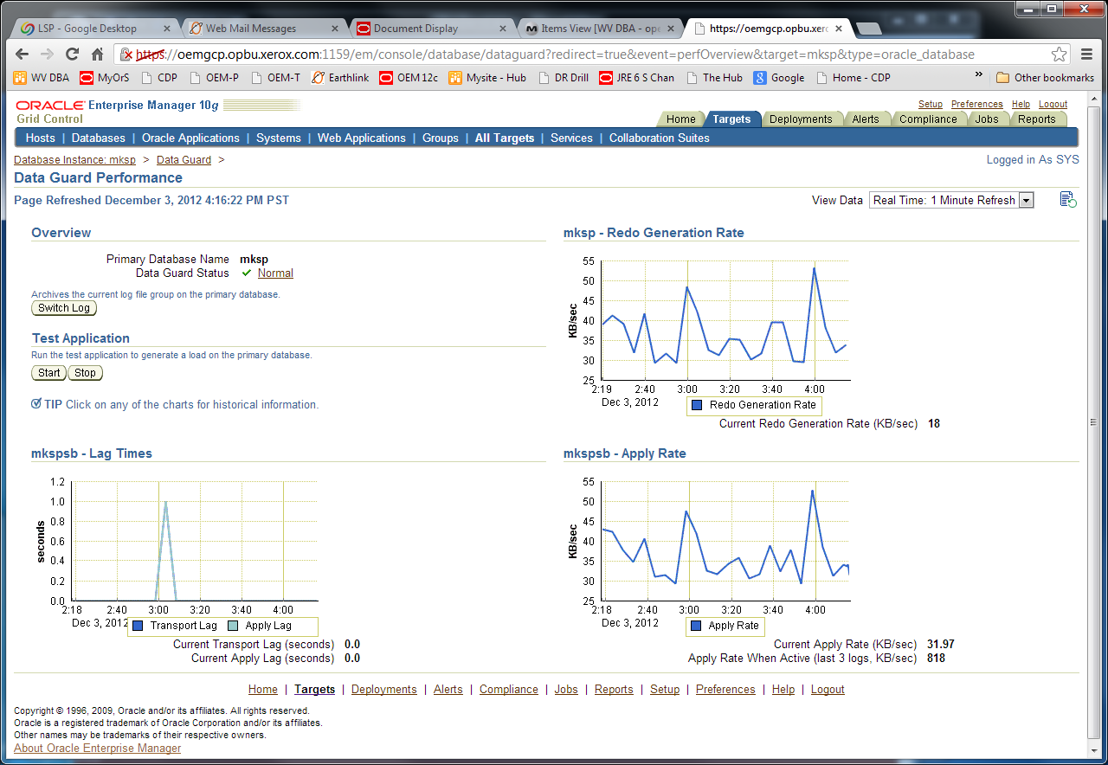
The top is the Primary, the bottom is the Standby

Slide 22
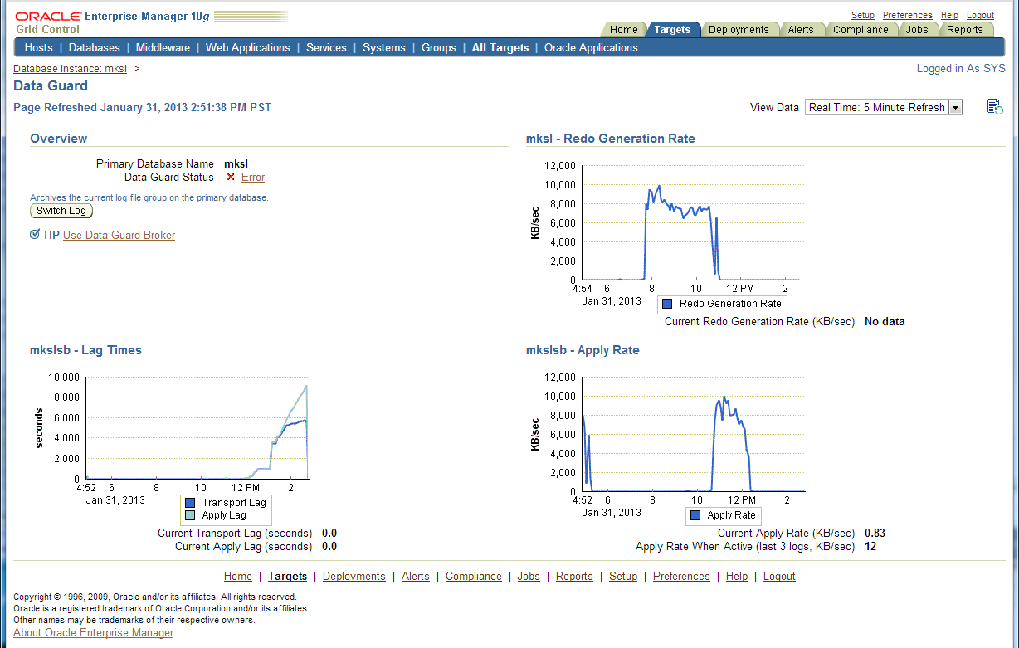
During this time the standby stopped applying logs as the disk was full

Slide 23

These are some of the alerts that EM will send
Target Name=mksl
Message=The Data Guard status of mksl is Error ORA-16778: redo transport error for one or more databases.
Metric=Data Guard Status
Target Name=mksl
Message=The Data Guard status of mksl is Error ORA-16662: network timeout when contacting a database.
Target Name=mksl
Message=The Data Guard status of mkslsb is Error ORA-16198: Timeout incurred on internal channel during remote archival.

Slide 24

Initial Standby database needs to be created as a copy of the Primary
  Can use rman duplicate
  For very large databases or slow network can get backup to DVD/tape and overnight to remote site
Standby needs its own Control File
  ALTER DATABASE CREATE STANDBY CONTROLFILE AS ‘..’;
Create Standby listener
  If using Data Guard Broker edit listeners
    Primary (GLOBAL_DBNAME=<primary>_DGMGRL)
    Standby (GLOBAL_DBNAME=<standby>_DGMGRL)
Startup mount and start recovery
  ALTER DATABASE RECOVER MANAGED STANDBY DATABASE USING CURRENT LOGFILE DISCONNECT FROM SESSION;

Slide 25

A few of the parameters used in the Standby
db_name = <name of Primary>
db_unique_name = <name of Standby>
fal_server = <name of Primary>
standby_file_management = { auto | manual }
Auto allows datafiles to be automatically added on Standby when done on Primary
db_file_name_convert = '/mksl/oradata/mksldata/','/u02/mkslsb/oradata/mkslsbdata/'
log_file_name_convert = '/mksl/oradata/mksldata/','/u02/mkslsb/oradata/mkslsbdata/’
log_archive_min_succeed_dest= 1
log_archive_config = "DG_CONFIG=(mksl, mkslsb)"
Set DG_CONFIG to a text string that contains the comma separated DB_UNIQUE_NAME of each database in the configuration

Slide 26
log_archive_dest_n has many options
  LOCATION – local, SERVICE- remote
  DELAY
  AFFIRM SYNC (Max Protection)
  NOAFFIRM ASYNC (Max Performance)
  MAX_CONNECTIONS
  VALID_FOR = (ONLINE_LOGFILE | STANDBY_LOGFILE | ALL_LOGFILES,
  PRIMARY_ROLE | STANDBY_ROLE | ALL_ROLES)
log_archive_dest_1 = "LOCATION=/u02/mkslsb/lg01/mkslsbarch/
VALID_FOR=(ALL_LOGFILES, ALL_ROLES)
DB_UNIQUE_NAME=mkslsb "
log_archive_dest_2 = "SERVICE=mksl ASYNC
VALID_FOR=(ONLINE_LOGFILE, PRIMARY_ROLE)
DB_UNIQUE_NAME=mksl "
log_archive_dest_state_1 = enable
log_archive_dest_state_2 = enable

Slide 27

There are many data dictionary views that are relevant to data guard
The next few slides show some of them.
  The SQL used is in the notes.

Slide 28

On Primary database
NAME OPEN_MODE DATABASE_ROLE DB_UNIQUE_NAME
---------- ------------ -------------------- ---------------
MKSL READ WRITE PRIMARY mksl
On Standby database
NAME OPEN_MODE DATABASE_ROLE DB_UNIQUE_NAME
---------- ------------ -------------------- ---------------
MKSL MOUNTED PHYSICAL STANDBY mkslsb
Notes:
SELECT name, open_mode, database_role, db_unique_name from v$database;

Slide 29

DEST_NAME STATUS DESTINATION TARGET
-------------------- ------------ ---------------------------- --------
ARCHIVER SCHEDULE REOPEN_SECS DELAY_MINS MAX_CONNECTIONS VALID_TYPE
--------- -------- ----------- ---------- --------------- ---------------
VALID_ROLE DB_UNIQUE_NAME
-------------- ---------------
LOG_ARCHIVE_DEST_1 VALID /u02/mkslsb/lg01/mkslsbarch/ LOCAL
ARCH ACTIVE 300 0 1 ALL_LOGFILES
ALL_ROLES mkslsb
LOG_ARCHIVE_DEST_2 VALID mksl REMOTE
LGWR PENDING 300 0 1 ONLINE_LOGFILE
PRIMARY_ROLE mksl
STANDBY_ARCHIVE_DEST VALID /u02/mkslsb/lg01/mkslsbarch/ LOCAL
ARCH ACTIVE 300 0 1 ALL_LOGFILES
ALL_ROLES NONE
Notes:
SELECT dest_name, status, destination, target, archiver, schedule, reopen_secs,
delay_mins, max_connections, valid_type, valid_role, db_unique_name
FROM v$archive_dest WHERE status != 'INACTIVE‘’

Slide 30

THREAD# GROUP# SEQUENCE# STATUS ARCHIVED FIRST_CHANGE# FIRST_TIME NEXT_CHANGE# LAST_TIME ------- -------- ---------- ---------- --------- ---------------- --------------- --------------------- ---------------
1 4 4520 ACTIVE YES 10907249776636 31-JAN 10:01:52 10907249986689 31-Jan 10:58:14
1 5 0 UNASSIGNED NO
1 6 0 UNASSIGNED NO
1 7 0 UNASSIGNED NO
Notes:
col First_Time format a15
col Last_time format a15
col FIRST_CHANGE# format 999999999999999999
col NEXT_CHANGE# format 999999999999999999
SELECT thread#, group#, sequence#, status,archived, first_change#,
to_char(first_time,'dd-mon hh24:mm:ss') first_time,
next_change#, to_char(last_time,'dd-mon hh24:mi:ss') last_time
FROM v$standby_log order by 1,2,3,4;

Slide 31

THREAD# LOW_SEQUENCE# HIGH_SEQUENCE#
----------- ------------- --------------
1 3048 3050
Notes:
SELECT * FROM V$ARCHIVE_GAP;

Slide 32

NAME VALUE DATUM_TIME
------------------------ ---------------- ------------------------
apply finish time +00 00:02:00.605
apply lag +00 01:47:30 01/31/2013 10:58:18
estimated startup time 14
transport lag +00 01:29:36 01/31/2013 10:58:18
## APPLY FINISH TIME - An estimate of the time needed to apply all received, but unapplied redo from the primary database.
## APPLY LAG – How long the data in a standby database lags behind the data in the primary database.
## ESTIMATED STARTUP TIME - An estimate of the time needed to start and open the database in seconds.
## TRANSPORT LAG – A measure of the transport of redo to the standby database lags behind the generation of redo on the primary database.
Notes:
COLUMN NAME FORMAT A24
COLUMN VALUE FORMAT A16
COLUMN DATUM_TIME FORMAT A24
SELECT name, value, datum_time FROM v$dataguard_stats order by name;

Slide 33

REG CREA THRD APLD SEQ# FIRST_CHANGE# NEXT_CHANGE# COMPT_TIME
--- ---- ---- ---- ----- --------------- --------------- ---------------
RFS ARCH 1 YES 782 10906917578148 10906920384710 30-JAN 17:01:09
. . . . .
RFS ARCH 1 YES 3607 10907223999049 10907223999089 31-JAN 09:01:36
RFS ARCH 1 NO 3608 10907223999089 10907223999134 31-JAN 09:01:52
RFS ARCH 1 YES 3608 10907223999089 10907223999134 31-JAN 09:01:42
RFS ARCH 1 YES 3609 10907223999134 10907223999171 31-JAN 10:01:37
RFS ARCH 1 YES 3610 10907223999171 10907223999216 31-JAN 10:01:44
## APPLIED: IN-MEMORY, log file has been applied in memory, but datafiles have not yet been updated.
## APPLIED: YES, datafiles have been updated.
Notes:
col REGISTRAR format a8
col CREATOR format a6
col THREAD# format 999
col APLD format a10
col Compt_Time format a15
col FIRST_CHANGE# format 999999999999999999
col NEXT_CHANGE# format 999999999999999999
SELECT registrar reg, creator crea, thread# thrd, applied apld, sequence# seq#, first_change#, next_change#,
to_char(completion_time,'dd-mon hh24:mm:ss') compt_time
FROM v$archived_log WHERE completion_time > sysdate - 1;

Slide 34

DEST_NAME RECOVERY_MODE STATUS ARCHIVED_THREAD# ARCHIVED_SEQ# APPLIED_THREAD# APPLIED_SEQ#
-------------------- ------------- ---------- ---------------- ----------- --------------- ------------
LOG_ARCHIVE_DEST_1 IDLE VALID 1
4519 0 0
LOG_ARCHIVE_DEST_2 IDLE VALID 0
0 0 0
STANDBY_ARCHIVE_DEST IDLE VALID 1
3773 1 3608
Notes:
col DEST_NAME format a20
col RECOVERY_MODE format a26
col STATUS format a10
set linesize 200
SELECT dest_name, recovery_mode, status, archived_thread#, archived_seq#, applied_thread#, applied_seq#
FROM v$archive_dest_status WHERE status ='valid';

Slide 35

TIME ERROR_CODE MESSAGE
--------------- ---------- ---------------------------------------
22:59:22 03-FEB 0 ARC0: Archival started
22:59:23 03-FEB 0 ARC1: Archival started
22:59:23 03-FEB 0 ARC2: Archival started
22:59:23 03-FEB 0 ARC1: Becoming the 'no FAL' ARCH
22:59:23 03-FEB 0 ARC2: Becoming the heartbeat ARCH
22:59:23 03-FEB 0 ARC2: Becoming the active heartbeat ARCH
22:59:24 03-FEB 0 ARC3: Archival started
22:59:29 03-FEB 0 Attempt to start background Managed Standby Recovery process
22:59:29 03-FEB 0 MRP0: Background Managed Standby Recovery process started
22:59:31 03-FEB 0 Primary database is in MAXIMUM PERFORMANCE mode
22:59:31 03-FEB 0 RFS[1]: Assigned to RFS process 5396
22:59:31 03-FEB 0 RFS[2]: Assigned to RFS process 5398
Notes:
col MESSAGE format a80
col TIME format a15
SELECT to_char(timestamp,'hh24:mi:ss dd-mon') time, error_code, message FROM v$dataguard_status;

Slide 36
22:59:34 03-FEB 0 Managed Standby Recovery starting Real Time Apply
22:59:34 03-FEB 0 ARC3: Beginning to archive thread 1 sequence 4545 (10908513865971-10908582304950)
22:59:35 03-FEB 0 ARC3: Completed archiving thread 1 sequence 4545 (0-0)
22:59:37 03-FEB 0 Media Recovery Log /u02/mkslsb/lg01/mkslsbarch/log_4544_1_798129445.arc
22:59:38 03-FEB 0 Media Recovery Log /u02/mkslsb/lg01/mkslsbarch/log_4545_1_798129445.arc
22:59:39 03-FEB 0 Media Recovery Waiting for thread 1 sequence 4546 (in transit)
NOTE: server was patched and rebooted, continued where it left off
01:35:19 04-FEB 0 ARC3: Beginning to archive thread 1 sequence 4546 (10908582304950-10908640604514)
01:35:20 04-FEB 0 Media Recovery Waiting for thread 1 sequence 4547 (in transit)

Slide 37

On Primary database
PROCES SEQUENCE# STATUS DELAY_MINS
------ -------------- ---------------- ----------
ARCH 4573 CLOSING 0
ARCH 4574 CLOSING 0
LNS 4575 WRITING 0
On Standby database
PROCES SEQUENCE# STATUS DELAY_MINS
------ -------------- ---------------- ----------
ARCH 0 CONNECTED 0
RFS 3777 RECEIVING 0
ARCH 4573 CLOSING 0
ARCH 4574 CLOSING 0
MRP0 4575 APPLYING_LOG 0
## APPLYING_LOG - Process is actively applying the archived redo log to the standby.
## WAIT_FOR_GAP - Process is waiting for the archive gap to be resolved
Notes:
col PROCESS for a6
col STATUS for a30
col SEQUENCE# for 9999999999999
SELECT process, sequence#, status , delay_mins FROM v$managed_standby WHERE status <> 'idle' ORDER BY sequence#;

